Slide 1
Technical College System of Georgia
FY23 Year-End Processing

Slide 2
Banner Year-End Objectives
Preparing for Year-End
Understanding the Tools to use
Processing Year-End
Report Parameters
Questions – Answers
Check List Items
Notes:
2

Slide 3
Banner Year-End Preparation – Getting Ready
Write Offs should be done and approved by SAO and hopefully updated in Banner by now. If not you should be waiting for your approval.
When ZFRWRIT is complete in audit mode always generate an output popsel to be used once SAO approves, to be used as your “input” popsel for the update mode.
Run a normal application of payments (TGRAPPL).
Using GLBDATA, GLAEXTR, run popsels CORRECT_PAYMENTS and CORRECT_CHARGES to find payments or charges not in their normal state.
ZFRAUDT will find application of payment errors. Run with parameter 04 = Y
ZFRAUDT also shows detailed receivable information

Slide 4
TGIACCD Queries
You can also use TGIACCD to ensure that all data is in its normal state
TGIACCD, Source Code R, W, X with balances < 0
TGIACCD, Source Code F with balances > 0
TGIACCD, Detail Code %P, Source Code C with balance > 0
Reversing Third Party Payment
TGIACCD, Detail Code %C, Source Code C with balance < 0
Reversing Third Party Charge
TGIACCD, Detail Codes 1% with balance > 0
(NOTE: 2%, 3%, 5% can also be queried)
TGIACCD, Detail Codes 4% with balance < 0
Using these queries, ZFRAUDT and the CORRECT_PAYMENTS and CORRECT_CHARGES population selections will help find application of payment errors that need to be corrected.

Slide 5
Banner Year-End Preparation, cont.
ZSRJV01 identifies marriages, shows charges liquidated from payments, provides revenue and receivable information
ZSRJV01 FA Summary should be customized in GTVSDAX based on how your college books into PeopleSoft.
You can only have 99 different detail codes in your FA summary on ZSRJV01.
Most JVs should have been worked and cleaned by term (ZSRJV01). Don’t forget to identify negative JVs that affects the Financial Aid Summary. Ex. Reversing TUIT married to reversing HO50.

Slide 6
Banner Year-End Preparation, cont.
Run TGRRCON and TGIACCD to identify credits.
Ensure no missing chart of accounts exists on TGRRCON
TGRRCON - Part A shows receivables. Verify that no payment codes are in Part A. Balance to a Positive Aging - TGRAGES (balances .01 to 9999999.99)
Do any receivables need to be re-classified at this time?
See slide 7 in this PowerPoint
TGRRCON – Part B shows unapplied payments. Verify that no charge codes are in Part B. Balance to a negative Aging – TGRAGES (balances -9999999.99 to -.01)
Do any refunds need to be generated prior to year end? Get them done ASAP (use Part B of TGRRCON as a guide)
All remaining refunds and checks should be generated (ZSRRFND, ZFRCHEK).

Slide 7
Banner Year-End Preparation, cont.
Reclassify any receivables
Optionally, any reclassifications should be done.
Use process ZFPRCLS to take any PLRF, SEOR, HOGR, LOSR, etc. refunds out of the appropriate fund source and move them to tuition. Re-class any PELC, HOGC, etc. to BOOK.
ZFPRCLS can be ran by term or across the board and may require un-applying and reapplying for the semester.
ZFPRCLS is for charges only.
Just be sure to KNOW YOUR DATA!!
If you do not currently re-class, don’t start now. Wait until after year end and make sure to discuss with your VPA first!

Slide 8
Banner Year-End Processing Steps
The amount of down time that the business office requests should depend on the cleanliness of your data, the size of your college and the speed of Banner.
Your BPL should lock out any users who will be updating information onto student accounts.

Slide 9
Banner Year-End Processing Steps
Financial Aid Reconciliation Reports Needed:
Ensure FA reconciles State(ZFRGSFC) and Federal Funds(RERGRNT) – ask for copies of the reconciled reports!!!
COD for Pell and Loans that ties to Banner at June 30 with no discrepancies
SURFER reconciliations at June 30 with no discrepancies
These are reports that your VPA may need during audits, so they are good to have to put with your other Year End reports

Slide 10
Banner Year-End Processing Steps
No payments should be made via the web after some cut off time or NLT the AM of June 30. Make sure RTS Manager and the web are shut down. Have BPLs disable links for web student payments, online applications and transcripts.
If you use Web Transcript, set GTVSDAX internal code to N for the external code TRANSREQ.
ALL cashier sessions should be finalized, fed, and reported at some cut off time NLT June 30. TGACSPV (the first screen) must be empty; there should be no skipped data on TGRFEED. Unless you are future dating.
All application of payment errors should be verified and/or corrected. If no future dating, set Parm 9=Y to find students with issues.
Use ZFRAUDT to identify any final Application of Payment errors (pop sels can also be run).

Slide 11
Banner Year-End Processing Steps
All fiscal year JVs should be verified making last minute adjustments.
Run TGRRCON. All Part B entries (Unapplied Payments) should be accounted for and there should be minimal to no entries on Part B. Are you future-dating fall?
Ensure that nothing is on TGRRCON in 'Applied Not Fed' or 'Not Fed', unless it is truly un-earned revenue.
You will have to run a ZDLFEED one final time to ensure the GURFEED information is cleared.

Slide 12
Banner Year-End Processing Steps
If additional Banner data is entered, an End of Day process must be re-run (TGACSPV must be empty and no skipped data on TGRFEED).
If application of payment changes are made only, TGRAPPL, ZDLFEED, TGRFEED, and ZDLFEED processes must be run.
After all balancing, the following reports should be run: ZSRJV01 & ZSRDETL – all semesters(20CY%,20NY%), TGRRCON, TGRAGES (positive, negative, TGRAGES*), ZFRAUDT**, ZSRDEPO.
*with popsel WITH_BALANCES ** < 202312 , < 999999

Slide 13
Banner Year-End Processing Steps
Positive Aging (TGRAGES) should match TGRRCON part A.
Negative Aging (TGRAGES) should match TGRRCON part B.
Account for any miscellaneous cash and revenue. It is ideal to have $0 for cash and revenue application fees.
Account for any prepaid scholarship liabilities(ZSRDEPO).
Check ZFRAUDT’s recap (last page) by PRIORITY code. There should be no priority codes 900 or 990. Balance the totals. No balances should be on FA detail codes.

Slide 14
Banner Year-End Processing Steps
After all balancing of Banner, it is recommended to extract fiscal year data from TGIACCD so future pivot tables can be done as data requests are made. For example: FW% - fee waivers, un-earned revenue
Since TGIACCD can be slow, you may have to extract term data in pieces by source code (may not be feasible) – Try WEBUTIL, FILE, TXT changing GUAUPRF if necessary.
Also, run TGIACCD and extract data greater than 20CY17. You may also want to run ZSRDETL to snapshot the 20NY% activity -- 202412.
(CY= current year, NY=next year)

Slide 15
Banner Year-End HELP!!! FAQs --- Where, what, how?
Q: How long should I be allowed to be down for Year-End?
A: 2-3 days
Q: Should all users be out of the system when I start balancing?
A: YES
Q: What are my receivables?
A: TGRRCON & ZFRAUDT
Q: What is my cash and revenue?
A: ZSRDETL and ZSRJV01
Q: How do I see my application of payment issues?
A: ZFRAUDT, Pop Sels & TGIACCD Queries
Q: How can I see the remaining liability to the college?
A: TGRRCON B & ZSRDEPO

Slide 16
Banner Year-End Help!!! FAQs
Q: What shows me my JV entries?
A: ZSRJV01
Q: What identifies reversing JVs (marriages) and how do I fix them?
A: ZSRJV01 Parm 13=Y then unapply & reapply as needed
Q: How do I know if my data is clean?
A: TGRRCON Part A should balance to Positive Aging
TGRRCON Part B should balance to Negative Aging
Q: What can TGIACCD be used for?
A: Pivot tables for future data requests
Q: How can I tell if all of my sessions are reported and processed?
A: TGACSPV must be empty and no skipped data on TGRFEED

Slide 17
Banner Year-End Help!!! FAQs
Q: How can I tell if all of my data has been fed?
A: TGRRCON
Q: If I have to un-apply/reapply accounts, what do I do next?
A: TGRAPPL, ZDLFEED, TGRFEED and ZDLFEED must be run again
Q: What happens if TGIACCD won’t extract or I get errors?
A: Contact your BPL!

Slide 18
Banner Year-End Helpful Information
**ZSRDETL:
This is the accounting detail report. It can show revenue and receivables based on the parameters you enter.
Suggested uses for this report:
Run in the “ALL” mode to capture all revenue for a given term or fiscal year.
Run in the Negative mode to identify students who may need refunds.
Run in the Open mode to identify students with balances.
Run in the Memo, Contract or Authorization mode(s) to ensure all financial aid or third parties are either posted or identified for reversal prior to generating refunds.
Run with a popsel to identify certain revenue for certain student types, i.e. High School students.
Run with a popsel to identify any group of students requested (certain major/classes, mini-mesters).
Use the text file feature to pull into an Excel spreadsheet to identify receivables or potential trends (by major, etc.).
**Email me for documentation if needed

Slide 19
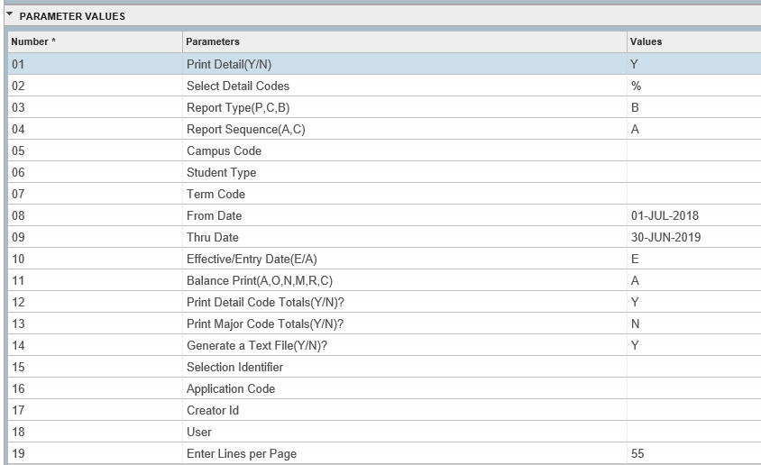
Banner Year-End Helpful Information
ZSRDETL:
Year-End Parameters:
Change date as needed. for 2023 the date would be 01-JUL-2022
Change date as needed. for 2023 the date would be 30-JUN-2023

Slide 20
Banner Year-End Helpful Information
**ZFRAUDT:
This is the Reconciliation report. It shows your receivables based on the parameters you enter.
Suggested uses for this report:
Use this report to pull any outstanding receivables.
Run this report with parameter 04 = Y and it will show you any application of payment issues.
Useful report to check receivable balances before running ZSRRFND to make sure everything is married correctly and your refunds will be correct.
**Email me for documentation if needed

Slide 21
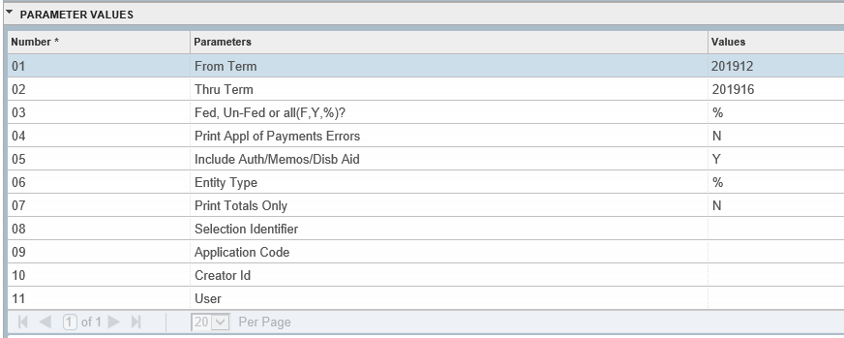
Banner Year-End Helpful Information
ZFRAUDT:
Year-End Parameters
Change term as needed. For 2023 the term would be 202312
Change term as needed. For 2023 the term would be 202316
Y

Slide 22
Banner Year-End Helpful Information
**Email me for documentation if needed
**ZSRJV01:
ZSRJV01 prepares a report of all application of payments by the selected time frame (term or date-driven). ZSRJV01 reports JV information for purposes of balancing student accounts and for justification of booking into PeopleSoft.
Suggested uses for this report:
This report shows what is married to what.
Run this report with parameter 13 = Y and parameter 07 = N and it will show you any negative marriages. This can cause your FA Recap totals to not balance to your TGIACCD totals.
Remember that your FA Recap is now controlled by GTVSDAX entries so make sure you have those setup the way you need them
TIP: During the year, run ZSRJV01 parameter 13 = Y and parameter 07 = N by DATE (01-JUL-XX – 30-JUN-XX) instead of term to pick up any issues you may from payments being made for prior terms that would not be picked up if you were running for current year semesters.

Slide 23
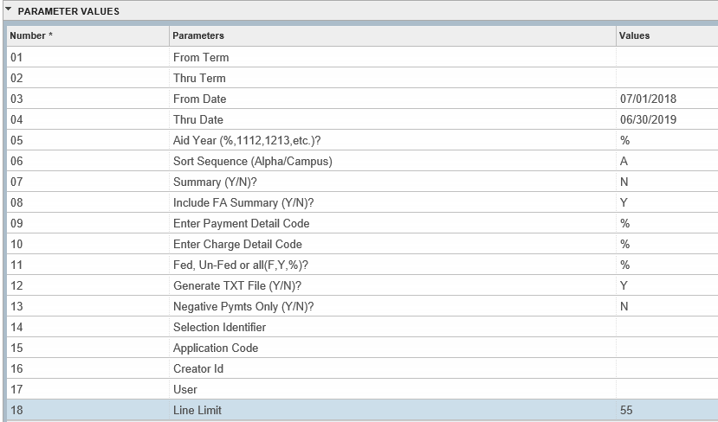
Banner Year-End Helpful Information
ZSRJV01:
Year-End Parameters
Change date as needed. for 2022 the date would be 07/01/2022
Change date as needed. for 2022 the date would be 06/30/2023

Slide 24
Banner Year-End Helpful Information
TGRRCON:
Is your A/R Reconciliation Report. This report shows Open Charges(Receivables), Unapplied Payments, Misc Receipts, and deposits.
Run your End of Day processes BEFORE running TGRRCON.
Suggested uses for this report:
This report helps you to:
Verify entries into the GL are accurate
Verify accounting behind the detail codes is correct
Verify that your Subsidiary Ledger(AR) supports your GL balances
** Misc Receipts - If there are balances on APPL, 2APP, 3APPs, it is possible reversing entries for web admissions may not be accurate. That is the amount of cash and revenue that is essentially “dangling”. There is nothing that can be done about it, just account for this. Also need to ensure that TZMRCPT is clean so that should be added some where.

Slide 25
Banner Year-End Helpful Information
TGRRCON:
Year-End Parameters
Change date as needed. for 2023 the date would be 07/01/2022
Change date as needed. for 2023 the date would be 06/30/2023
***If your TGRRCON Part A does not match positive TGRAGES, you will want to leave Parameter 02 &03 blank. TGRAGES looks at any date range, so TGRRCON will need to do the same if not balancing.
If you start Pre-registration before June 30th, and you future date, you will have unfed data on Part A on June 30th and that is okay.
TUIT payments will feed, but will be in the Unfed column on Part B because the charge won’t feed until July 1st. But this is okay if you are future dating.
TGRRCON Part B should be empty at year end unless you future date.
TGRRCON only cares about A/B Account data. TGRAGES only cares about PIDMS. If these reports are out of balance, you could have an orphaned PIDM

Slide 26
Banner Year-End Helpful Information
TGRAGES:
This report is used to analyze past due accounts. It produces a list of accounts by billed date, due date, or effective date with up to three age-date range options. The Invoice/Statement Report (TFRBILL, TSRCBIL or TSRTBIL) must have been run in STATEMENT mode in order to use billed or due dates. The report lists unpaid account balances within each age-date range in addition to future balances
Suggested uses for this report:
This report helps you to:
Balance to the TGRRCON Report
Positive Aging Report should balance to Part A of TGRRCON
Negative Aging Report should balance to Part B of TGRRCON
Run to find problem accounts from reconciliation

Slide 27
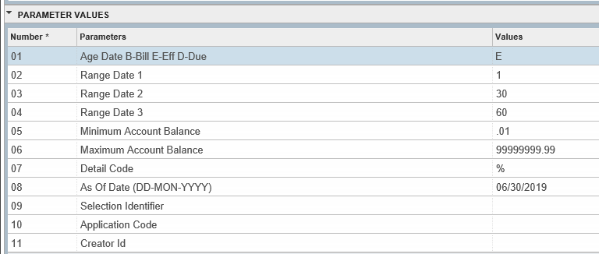
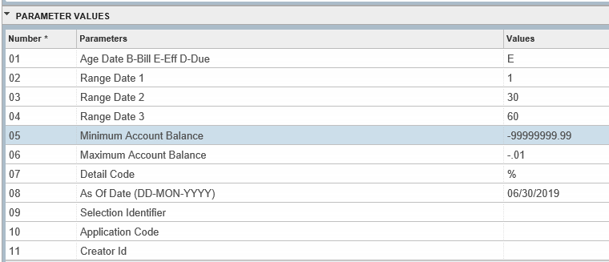
Banner Year-End Helpful Information
TGRAGES:
Year-End Parameters
Positive Aging:
Change date as needed. for 2023 the date would be 06/30/2023
Negative Aging:
Change date as needed. for 2023 the date would be 06/30/2023

Slide 28
Banner Year-End What if things don’t balance?
Identify accounts that don’t balance
Check to see if everything is in it’s normal state ***EVEN FOR PRIOR YEARS*** Payments or other things could have occurred in the current FY date range
Application of Payments could have made changes to the accounts
If they have a balance <> 0, they are included on TGRRCON & TGRAGES
Review the GL for manual postings
Identify detail codes that may be involved
Run aging reports for detail codes in out-of-balance accounts and review accounts
Lessons Learned

Slide 29
Banner Year-End What if things don’t balance?
If TGRRCON and TGRAGES don’t balance:
Re-run TGRRCON with Parameter 02 & 03 blank
Do you have an orphaned pidm? EVEN FOR PRIOR YEARS/TERMS
SQL scripts looking for TBRACCD_PIDM not in (SPRIDEN_PIDM)
Person with multiple pidms that have been merged
AR data not merged or fed before deletion
Clean up any orphaned pidms – script added to find ALL
Make sure term-based and Aid Year-based flags are in sync across detail codes.
Lessons Learned

Slide 30
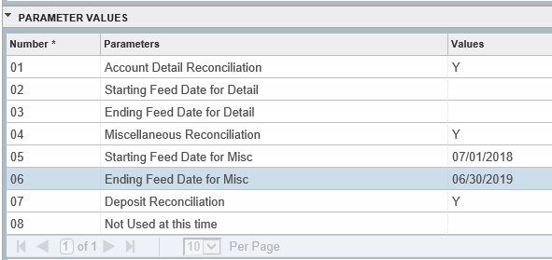
Banner Year-End What if things don’t balance?
Re-run TGRRCON leaving parameters 02 and 03 blank:
Change date as needed. for 2023 the date would be 07/01/2022
Change date as needed. for 2023 the date would be 06/30/2023
*** TGRAGES pulls data from the beginning of time, so if TGRRCON and TGRAGES are not balancing, re-running TGRRCON with the parameter set above will get them to balance.
Lessons Learned

Slide 31
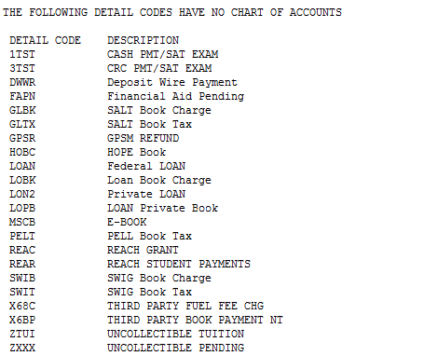
Banner Year-End What if things don’t balance?
What if they still do not balance???
Check TGRRCON to see if you have any detail codes that do not have the accounting detail behind them. i.e. A/B accounts.
If you have these, you should pull a TGIACCD query for these detail codes where the balance <>0
Remember TGRRCON only cares about A/B accounts, so if the detail code has no Chart of Accounts, then the balance sitting on that detail code will not be included on TGRRCON.
Lessons Learned

Slide 32
Banner Year-End What if things don’t balance?
What if they still do not balance???
If you have cleaned up any detail codes that do not have a Chart of Accounts and you are still out of balance, check to see if you balance over all.
From TGRRCON:
AR Balance for Total Open Charges (Receivables)
+ AR Balance for Total Unapplied Payments
---------------------------------------------------
= Sum of the two Aging Reports (TGRAGES)
Overall do they balance??
Are you out of balance the EXACT dollar amount on each side when comparing Part A to Positive Aging and Part B to Negative Aging??
If yes, then you may have some A/B accounts that are switched.
Lessons Learned

Slide 33
Banner Year-End What if things don’t balance?
Example:
TGRRCON:
Part A
$5,833,191.74
TGRAGES:
Positive
$5,752,242.32
Difference:
$80,949.42
Example:
TGRRCON:
Part B
-$232,369.61
TGRAGES:
Negative
-$151,420.19
Difference:
-$80,949.42
OVERALL
They balance
TGRRCON:
$5,833,191.74
+-$232,369.61
________________________________$5,600,822.13
TGRAGES:
$5,752,242.32
+-$151,420.19
________________________________
$5,600,822.13
Lessons Learned

Slide 34
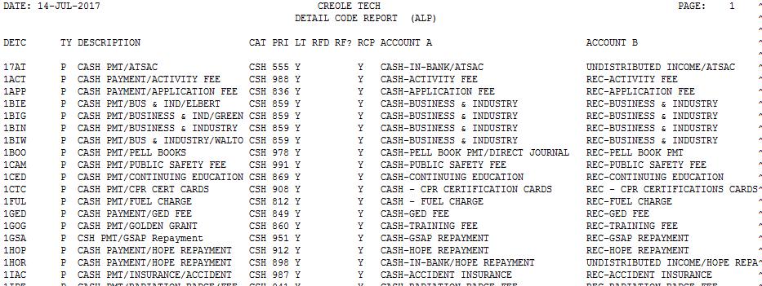
Banner Year-End What if things don’t balance?
To check to see if you have A/B Accounts that have been switched:
Run a ZXRDETC report. This will list all detail codes with the A/B accounts.
Review you’re A/B Accounts and see if you see any that have been switched or something is incorrect
Lessons Learned

Slide 35
Banner Year-End What if things don’t balance?
ZSRJV01
If TGIACCD totals do not balance to the FA recap totals:
Run ZFRAUDT Parm 04 = Y Check to see if you have any application of payments issues with the fund that is out of balance.
Run ZSRJV01 Parm 07 = N Parm 13 = Y Check to make sure you have no negative payments (negative JVs) with the fund that is out of balance.
Run ZSRJV01 Parm 07 = N Parm 9, 10, 11 = % Parm 13 = N This will run a full ZSRJV01. Pull this into a browser and search for the fund description that is out of balance and see if there is anything that might need to be unapplied and reapplied to get it in balance.

Slide 36
If I can’t help you, I can find someone that probably can, so don’t be afraid to ask!!!!!!

Slide 37
Questions or Comments????
Angela White Director, System Development and Support
Office of Administrative Services Technical College System of Georgia 1800 Century Pl. N.E., Suite 550 Atlanta, GA 30345 Direct: 770.265.7063 awhite@tcsg.edu
Tracy R. Moore Programmer/Analyst
Office of Administrative Services Technical College System of Georgia 1800 Century Pl. N.E., Suite 550 Atlanta, GA 30345 Direct: 770.312.0401 tmoore@tcsg.edu

